Slide 1
Using MTT (Manufacturing Task Tracker) June, 2011

Slide 2
Overview
Manufacturing Task Tracker (MTT) is the new centralized program for entering and reporting Safety, Environmental, Reliability, Quality, Health, and other Projects related to corrective actions and tasks at your site.
Notes:
An image of the MTT screen would be here. Also, if you are going to have a website with information about the MTT (faqs), this would be a good page to link to it.

Slide 3

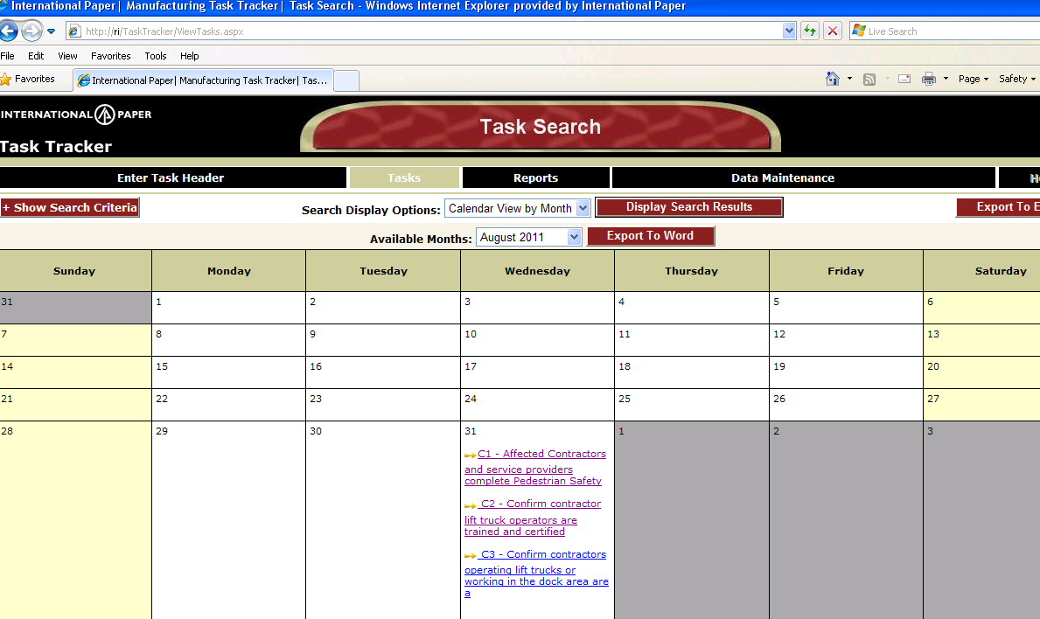
How to access MTT
Open Internet Explorer
Type tasktracker in address bar
Calendar of all tasks assigned to you will be displayed

Slide 4
Steps – Add NEW MTT
Create Task Header (Header is used to GROUP tasks together. Examples: One header and associates all environmental tasks or One header for all Environmental Monthly Reports and then associate only monthly reporting task etc..)
Create Tasks (Associated with a Task Header)
Perform Tasks
Update tasks information (including complete date)

Slide 5
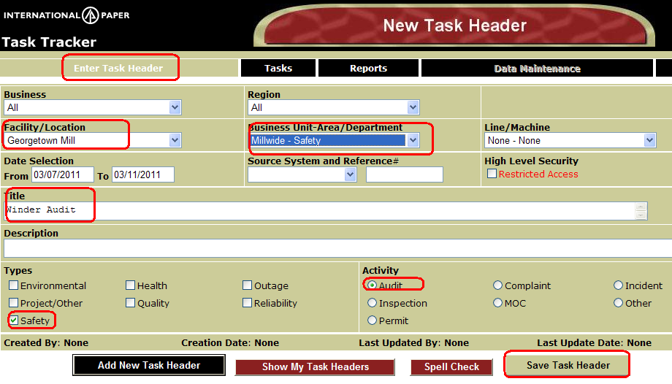
Create New Task “Header”
EXAMPLE: Georgetown Winder Audit
Click on Enter Task Header (top left)
Enter information (Site, Business Unit, Title, Types, Activity)
Click on Save Task Header

Slide 6
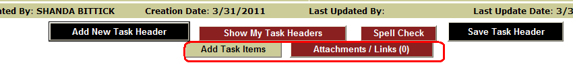
Add Actions and/or Attachment/Links for GT Winder Audit
Click on Add Task Items to begin adding tasks
Click on Attachments/Links to add documents or Web/Sharepoint links to Header

Slide 7
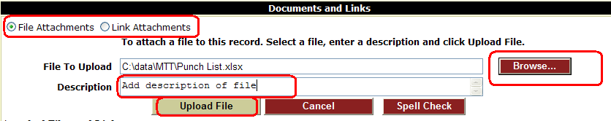
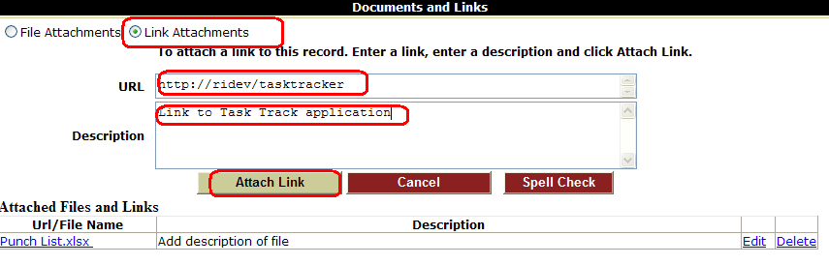
Add File Attachments (May add to Task Header or to individual Task.)
Select File Attachment
Browse and select file to attach
Add Description
Select Upload file
Add Link Attachments
Select Link Attachments
Browse and select file to attach
Add Description
Select Upload file

Slide 8
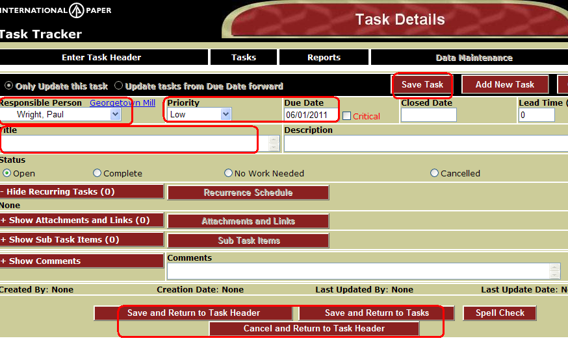
Add Task Items
Choose Responsible Person, Priority, Due Date, Enter Title
Click on Save Task to save and add recurrence schedule or to add another task to this Header
OR Click on Save and Return to Task Header to Save & Go to Task Header
OR Click on Save and Return to Task to Save task and Go to Calendar of tasks

Slide 9
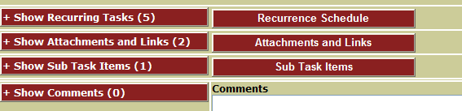
Updating Tasks
Access tasks to update with information or close task via
Hyperlink within email notification
Directly from calendar (Tasks)
Find Header and select task to update
Number of recurring tasks, attachments and sub task are in ()
Add/Update Recurrence Schedule
Add/Update Attachment (similar to adding to Task Header, but can also add for each tasks)
Add/Update SubTasks

Slide 10
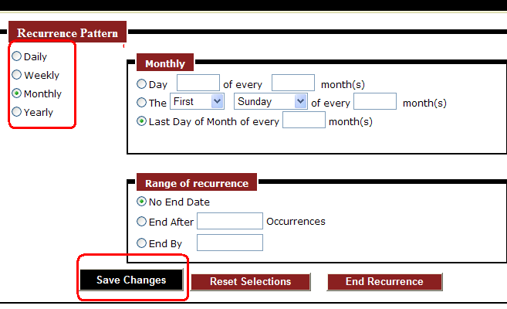
Recurrence Schedule
Can add recurrence option to task (daily, weekly, monthly, yearly)
Will create one tasks for each recurrence (will generate tasks 6 months in the future at all times)

Slide 11
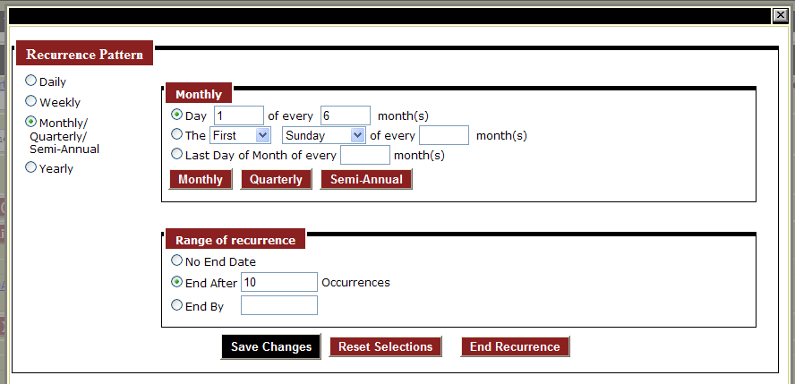
Monthly/Quarterly/Semi-Annual
Clicking on the buttons (Monthly – 1, Quarterly – 3, Semi-Annual-6) will populate the Months textbox with the appropriate number of months.

Slide 12
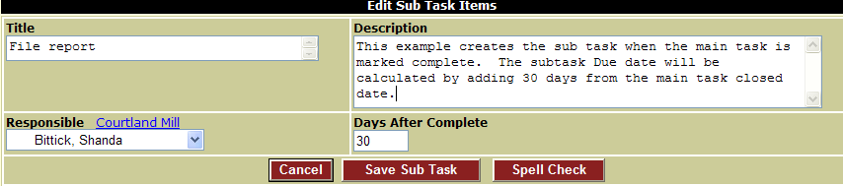
Subtasks
May add as many subtasks as desired at time of creation of original task or update
Sub task will be created once the main task has been marked completed

Slide 13
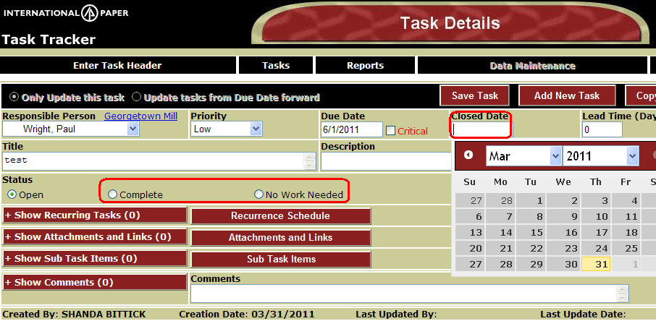
Closing Tasks
Access tasks to update with information or close task via
hyperlink within email notification
Directly from calendar (Tasks)
Find Header and select task to update
Close Tasks:
Choose Closed date Automatically marks Status as Complete
OR select status (Complete, No Work Needed or Cancelled) and will automatically mark Closed Date as today

Slide 14
Task – Special Features
Tasks are grouped under a Task Header. May enter none to many tasks for each header. Header is used to group so easier to find tasks associated. Example: All tasks identified on audit
Restricted Access Task Headers & Items: Only Business Managers, Type Managers, Responsible, and Creator can view or edit
When Critical checkbox by Due Date is marked – only Type manager (Example: Environmental Type) OR the person that created the tasks can change the due date
Can assign to a role (group of users). The responsible person will be updated to person closing/completing the tasks
Lead Time is used when want to override the defaults on notification. Example: If notification profile set to only receive task due in next 30 days and need this task to display 120 days before due date.

Slide 15
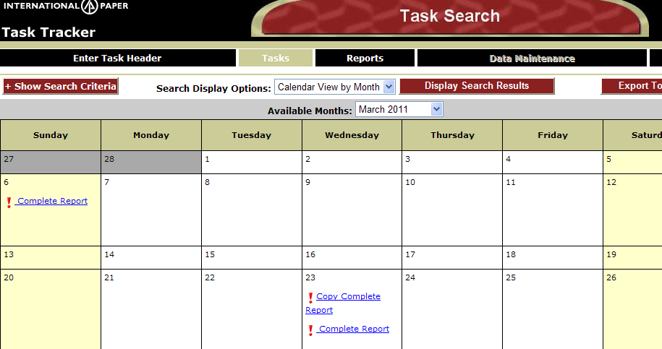
Default MTT view of Calendar with your Tasks

Slide 16
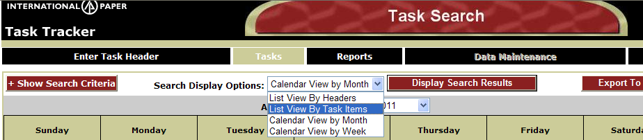
TASKS – Other Views/Features
Show Search Criteria (Examples on next page)
Search Display Options:
Default: Calendar View by Month
List View by Headers (Display in list format Title information of Task Headers)
List View by Task Items (Display in list format Title of Tasks Items)
Export to Excel

Slide 17
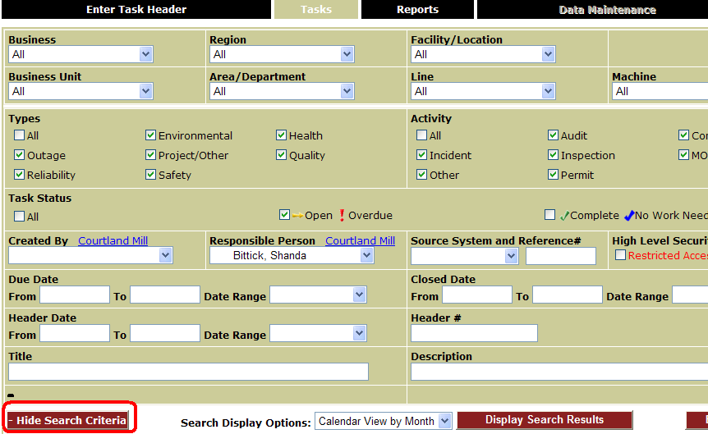
Show Search Criteria - Change Default MTT view
From TASKS (Calendar View) Click on Show Search Criteria to change defaults.
Default: Tasks assigned to YOU as the responsible person and are not complete
Defaults can be changed to set for facility, area, type, or combination of any of the selection criteria)
Click Display Search Results to see Calendar

Slide 18
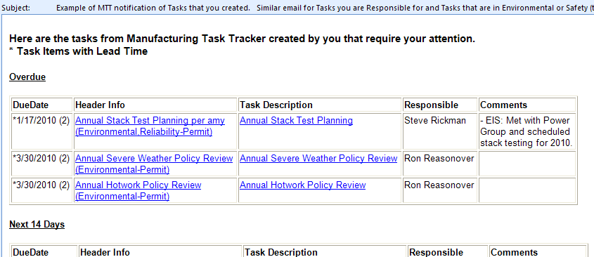
Example Email Notification:

